Slide 1
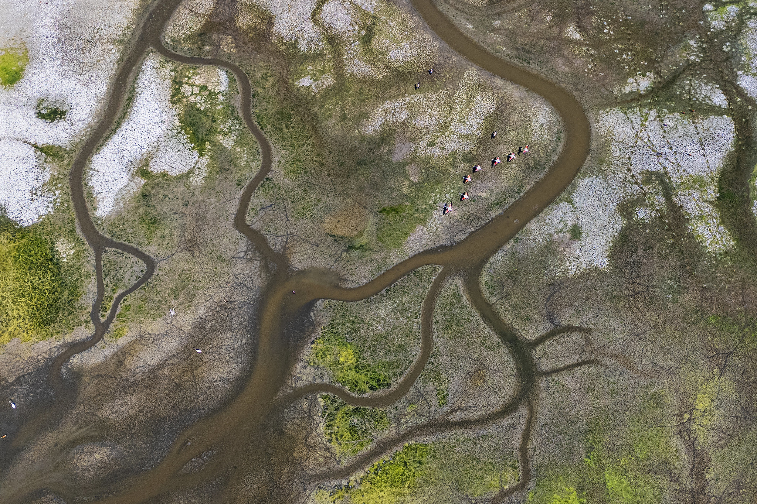

EU MS reporting on adaptation under Article 17
of the Governance Regulation
Technical Exchange Visit – Ukraine to the European Environment Agency
Copenhagen, Denmark, 21-23 October 2025
Angelika Tamásová, Climate Risk and Resilience Unit
© Hanifi Koç, Environment&Me 2025 / EEA
Notes:
This session will explore how EU Member States report on adaptation goals as part of their NECPs under Article 17.
It will showcase best practices, discuss common challenges, and provide recommendations for improving reporting quality and the effective use of data.
Participants will gain insights into approaches for linking adaptation goals to measurable outcomes and enhancing transparency and comparability across countries

Slide 2

Legislation

Slide 3
EU Legislative Framework
Regulation (EU) 2018/1999 on the Governance of the Energy Union and Climate Action
Article 4 National objectives, targets and contributions
Article 17 Integrated national energy and climate progress reports
Article 19 Integrated reporting on national adaptation actions
IMPLEMENTING REGULATION (EU) 2020/1208 on structure, format, submission processes and review of information reported by Member States pursuant to Regulation (EU) 2018/1999
Article 4 and Annex I - Reporting on national adaptation actions
IMPLEMENTING REGULATION (EU) 2022/2299 as regards the structure, format, technical details and process for the integrated national energy and climate progress reports
Annex III Decarbonisation - Adaptation progress reporting
Regulation (EU) 2021/1119 establishing the framework for achieving climate neutrality (‘European Climate Law’)
Article 5, 6, 7 – adaptation, progress assessments
EUR-Lex - 32022R2299 - EN - EUR-Lex
EUR-Lex - 32022R2299 - EN - EUR-Lex

Slide 4
EU Legislative Framework
Regulation (EU) 2018/1999 on the Governance of the Energy Union and Climate Action
Article 4 National objectives, targets and contributions
‘Each Member State shall set out in its integrated national energy and climate plan the following:
Regarding the ‘decarbonisation’ dimension
Other objectives and targets, including adaptation goals.’
Article 17 Integrated national energy and climate progress reports
‘By 15 March 2023, and every two years thereafter, each Member State shall report to the Commission on the status of implementation of its integrated national energy and climate plan by means of an integrated national energy and climate progress report covering all five dimensions of the Energy Union.’
COMMISSION IMPLEMENTING REGULATION (EU) 2022/2299
laying down rules for the application of Regulation (EU) 2018/1999 as regards the structure, format, technical details and process for the integrated national energy and climate progress reports
Article 2 and Annex III - Reporting on progress with respect to the decarbonisation dimension
MS shall report the information on adaptation referred to in Article 4, point (a)(1) of Regulation (EU) 2018/1999 in accordance with the formats set out in Annex III.
Annex III – Decarbonization: Adaptation
Table 1 Adaptation goals in integrated national energy and climate plans
Table 2 Information on adaptation, which may affect delivery of Energy Union objectives and
targets and the long-term Union GHG emission reduction commitments under the Paris Agreement

Slide 5

EU MS reporting on Article 17 Annex III

Slide 6

Article 17 Annex III workflow and delivery
Knowledge services
Networks and Collaboration services
Reporting services (data flows)
Data services
Reportnet 3
Article 17 dataflow and support
Article 17 dashboard
at the Climate and Energy in the EU website
2023 EEA briefing Is Europe on track towards climate resilience?
2026 EEA report (forthcoming)
Community of adaptation lead reporters

Slide 7
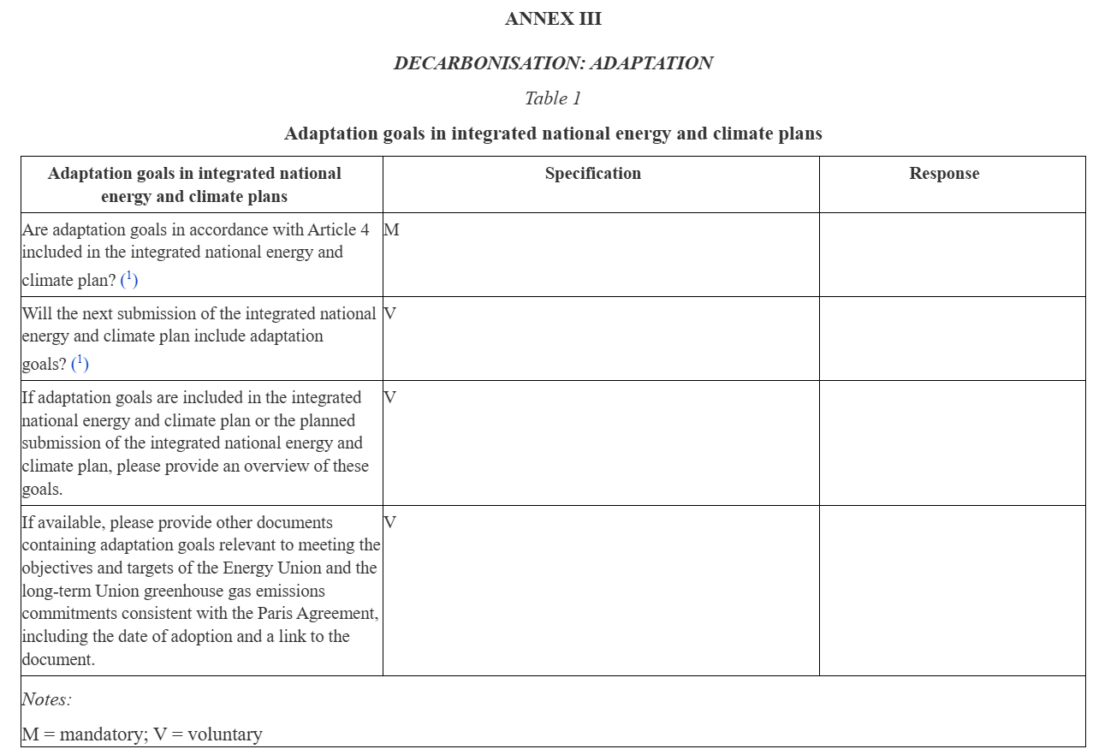
Adaptation goals
in integrated national energy and climate plans
Used for statistics.
Information available in the NECP or draft NECP.
Most EU MS link to other documents like NAS, NAP or sectoral and regional policies.
© Source

Slide 8
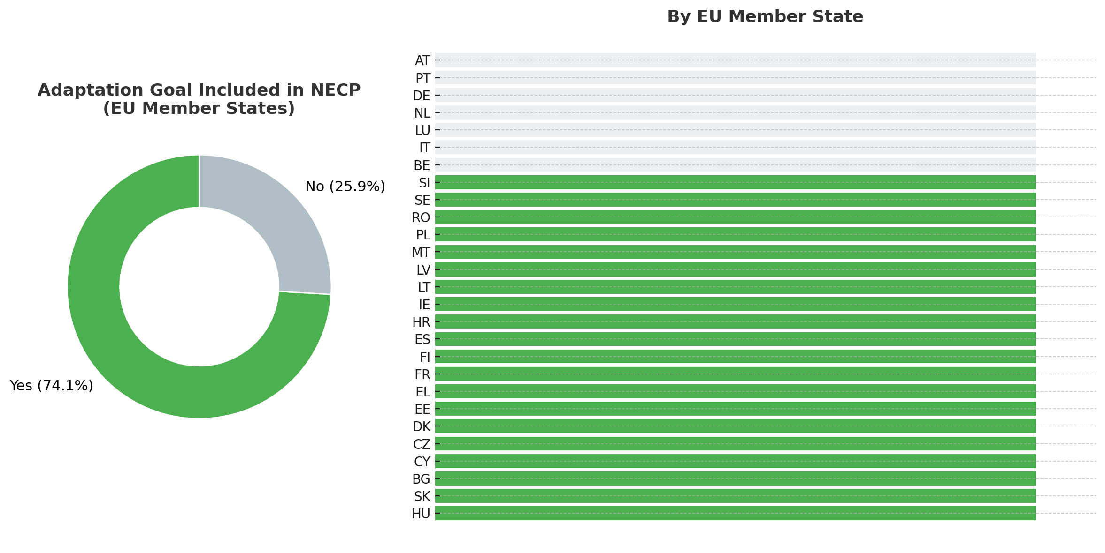
Adaptation goals
in integrated national energy and climate plans
Several key adaptation related principles appear:
avoiding maladaptation,
synergies between mitigation and adaptation,
integration of climate risk considerations into mitigation planning,
role of ecosystems as carbon sinks,
the principle of prevention.
Adaptation goals, due to various reasons, in some cases were not systematically integrated into the updated NECPs.
Adaptation goals are rarely considered for all five dimensions of the Energy Union.
Some MS recognize areas of synergies, where measures can contribute simultaneously to climate resilience and emissions reductions, signalling that future NECPs could better highlight such co-benefits.
© Source

Slide 9
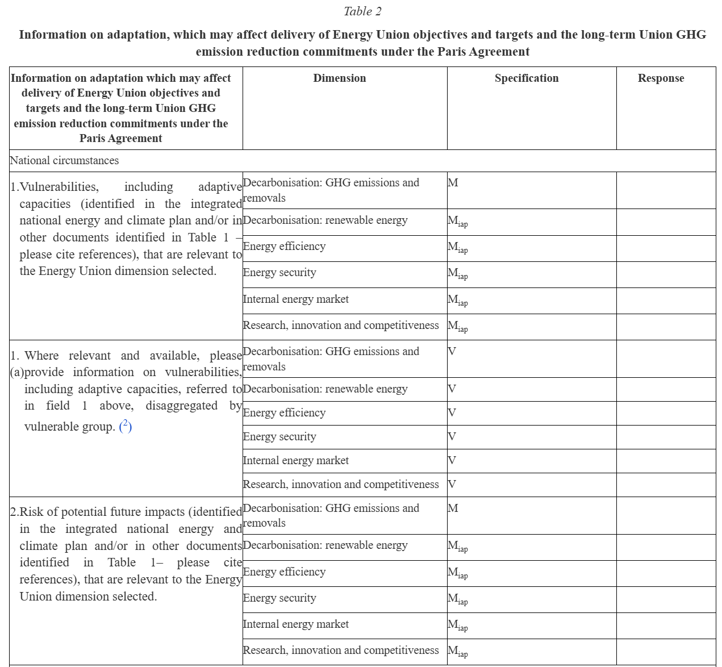
National circumstances
Vulnerabilities, including adaptive capacities
direct effects of extreme weather events, floods, heatwaves or drought to the demand and supply of the energy system
the reduction of energy production (hydropower, lignite power plant or nuclear power)
shortage of cooling water
decrease in agriculture and forestry
decrease of carbon sequestration combined with negative climate impacts on the amount of biomass available for energy production
challenges in forest management
© Source

Slide 10
National circumstances
Risk of potential future impacts
heat and heatwaves (hot spells), drought, extreme weather events with stronger storms as well as an increased amount of precipitation and its intensity
impacts of climate change on agriculture and forestry and the challenge in capturing carbon and carbon sequestration in forest, land and agriculture ecosystems
changes in the energy demand are likely due to climate change and climate vulnerability as well as decrease in energy consumption for heating and increase in energy demand for cooling
a potential threat to business continuity and supply chains
carbon sinks could become a potential emitter or have at least negative effect until the end of the century due to e.g. new fire territories that have not been impacted thus far or further degradation and reduction/shrinking of carbon sinks
© Source

Slide 11
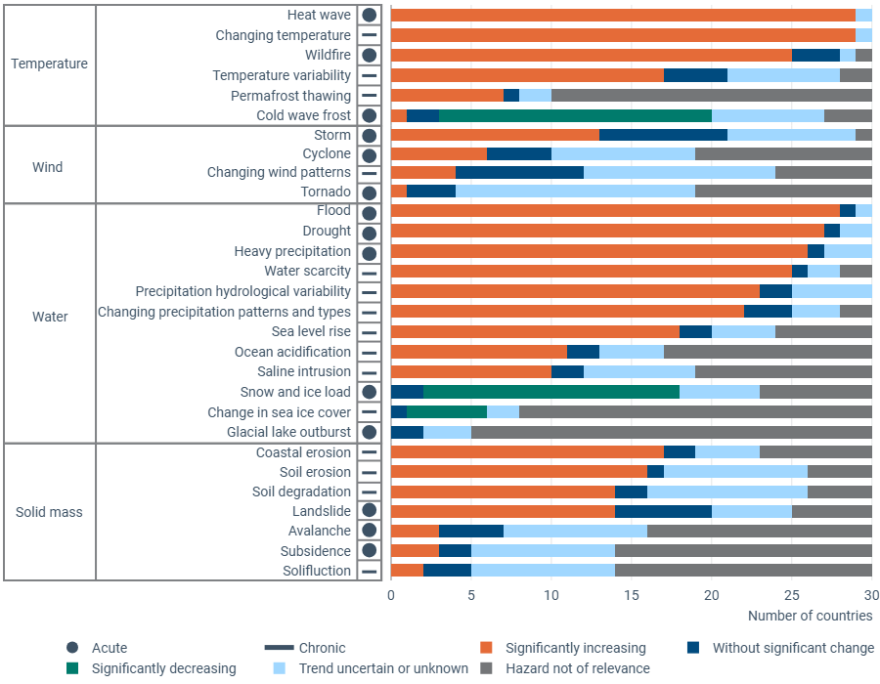
Key future hazards reported in 2025 under Article 19
In 2025, EU Member States, Iceland, Switzerland and Türkiye continued to report heatwaves, floods, droughts and heavy precipitation as the most frequently-occurring acute climate hazards.
Chronic hazards remain dominated by changing temperatures and hydrological variability.
The reported hazards under Article 17 seem to be in line with those hazards reported under Article 19 of the GovReg on national adaptation actions.
However, due to the different reporting structure a direct comparison cannot be made.
EEA (2025): From adaptation planning to action: Insights into progress and challenges across Europe (publication in November 2025)
National climate change adaptation planning and strategies, EU Dataset
© Source

Slide 12
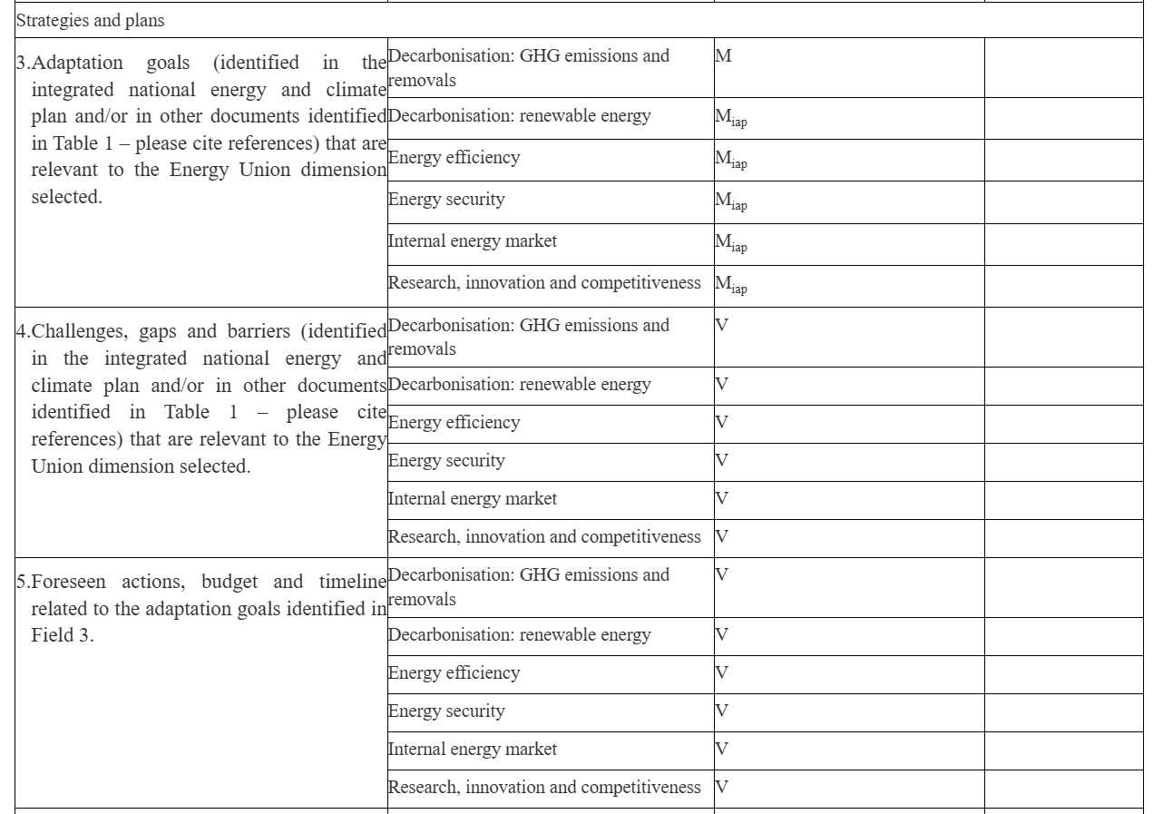
Strategies and plans
Adaptation goals
Two main approaches across MS:
some refer broadly to adaptation documents and overarching goals
others provide a more detailed listing of sectors, sectoral goals relevant for the Energy Union, based on their national assessments or strategies
without describing specificities regarding the decarbonisation dimension
many MS identify priority sectors as listed in their NECPs or by referencing sectoral focus areas from their national adaptation policies
energy sector; agriculture; forestry; the urban environment and buildings; water management; coastal protection; nature and biodiversity; infrastructure, transport, and land use; circular economy; disaster risk management and reduction of economic losses; tourism and cultural heritage
© Source

Slide 13
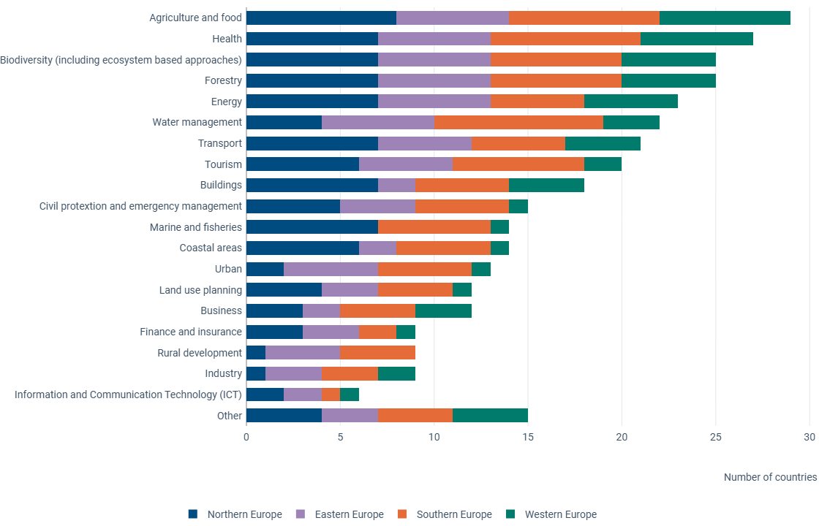
Key affected sectors reported in 2025 under Article 19
In 2025, EU Member States, Iceland, Switzerland and Türkiye reported agriculture and food as the most affected sector.
The health, biodiversity, forestry and energy sectors follow, reflecting a broadening recognition of sectoral vulnerability.
The reported sectors under Article 17 seem to be in line with those key affected sectors reported under Article 19 of the GovReg on national adaptation actions.
However, due to the different reporting structure a direct comparison cannot be made.
EEA (2025): From adaptation planning to action: Insights into progress and challenges across Europe (publication in November 2025)
National climate change adaptation planning and strategies, EU Dataset
© Source

Slide 14
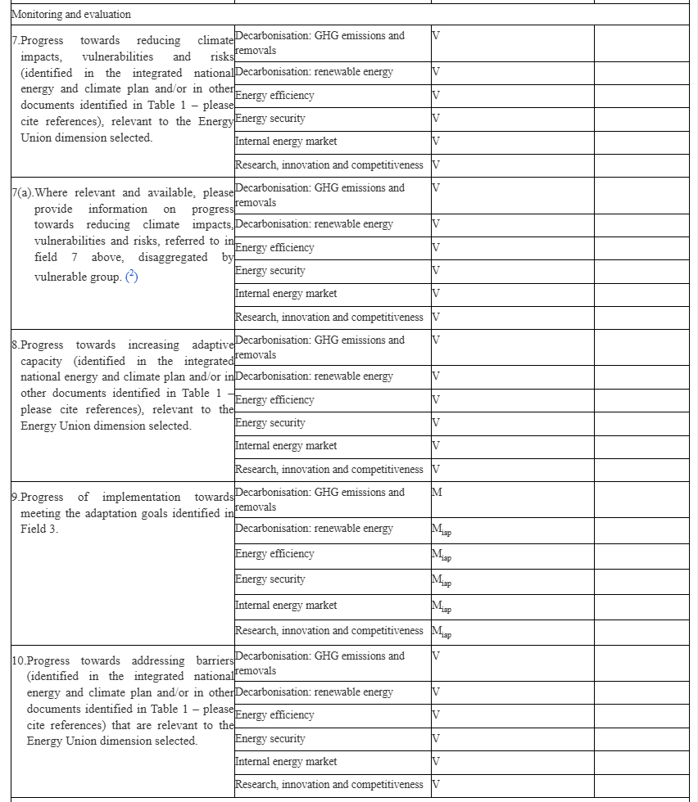
Monitoring and evaluation
Progress of implementation towards meeting the adaptation goals
Considerable variation in the data quality, availability and maturity of assessments:
no report on concrete progress towards adaptation goals
progress assessments are under way, with results not yet available
missing adaptation goals in NECPs
thorough methodology or systems to monitor and evaluate the implementation of the NECPs, or national adaptation policies not yet established.
progress assessments are still under development or expected soon.
Reference to the implementation of national adaptation policies as evidence of progress:
implementation of adaptation measures is underway,
established structures are in place or being set up to monitor progress towards adaptation goals.
expectation that ongoing activities - implementation of projects or establishment of institutional processes - are expected to contribute to progress in achieving adaptation goals, even if these are not presented as formal progress assessments
© Source

Slide 15

Key takeaways

Slide 16
Key takeaways
The reporting shows that Member States’ adaptation goals, defined in their national adaptation policies, are usually not organised along the Energy Union dimensions.
While it is not a requirement to organise adaptation goals along the Energy Union dimensions, the NECPs may specify how the included adaptation goals are addressing the Energy Union dimensions, especially decarbonisation.
In most EU Member States, monitoring and evaluation frameworks for measuring progress of implementation towards meeting the adaptation goals are under development or are recently implemented. Therefore, reporting is focusing on action implemented.
If operational, these frameworks are mostly structured around adaptation measures outlined in national adaptation strategies or plans, or follow an indicator-based approach, and might not consider synergies with the Energy Union dimensions.
Is Europe on track towards climate resilience? Status of reported national adaptation actions in 2023
© Source

Slide 17
Key takeaways
2025 - A mixed picture of Member States’ efforts.
Difficult to understand the progress made in implementing adaptation goals set in the NECPs, or other documents cross-referenced in the NECPs containing adaptation goals.
The heterogeneity of reporting practices and varying data quality makes it challenging to identify trends, challenges or good practices.
When interpreting Article 17 reported data, it is important to take into account reporting under Article 19 of the Governance Regulation
Article 19 reported data provides a comprehensive picture of national adaptation planning, implementation, monitoring and evaluation of adaptation policies and actions.
Article 17 reported data is more sector-oriented, exploring also co-benefits between mitigation and adaptation action.
Clarity, guidance and a harmonized approach between NECPs and NAS/NAP is needed.
© Source

Slide 18

?
© Hanifi Koç, Environment&Me 2025 / EEA
© Source

Slide 19

Good practices

Slide 20
Recommendations
Start with the Reporting guidelines
Potential sources are NECP, ‘other documents’ as NAS or NAP, progress reports and evaluations, expert judgement, inter-ministerial coordination is key, UNFCCC transparency framework reporting
Focus on the narrative, based on the mandatory reporting elements, and keep it consistent:
What are the adaptation goals defined in the NECP? What was the progress made towards achieving the mentioned goals in the last period?
How objectives or priorities of NAS or NAP support the adaptation goals defined in the NECP? What adaptation actions were planned or implemented?
Are there any identified synergies between adaptation and mitigation, what are the mitigation co-benefits of adaptation actions?
What are the hazards, vulnerabilities and future impacts?
Focus primarily on sectors /sectoral policies covered in the NECP in a consistent way – for example: energy, industry, business, agriculture and food, forestry, transport, water management, buildings, land use planning, urban
Once the narrative is clear, see how it fits with the dimensions of the Energy Union and decide which information fits where:
(M) Decarbonisation: GHG emissions and removals, (V) Decarbonisation: Renewable energy, Energy efficiency, Energy security, Internal energy market, Research, innovation and competitiveness
If possible and available, provide complementary information on voluntary elements
© Source

Slide 21
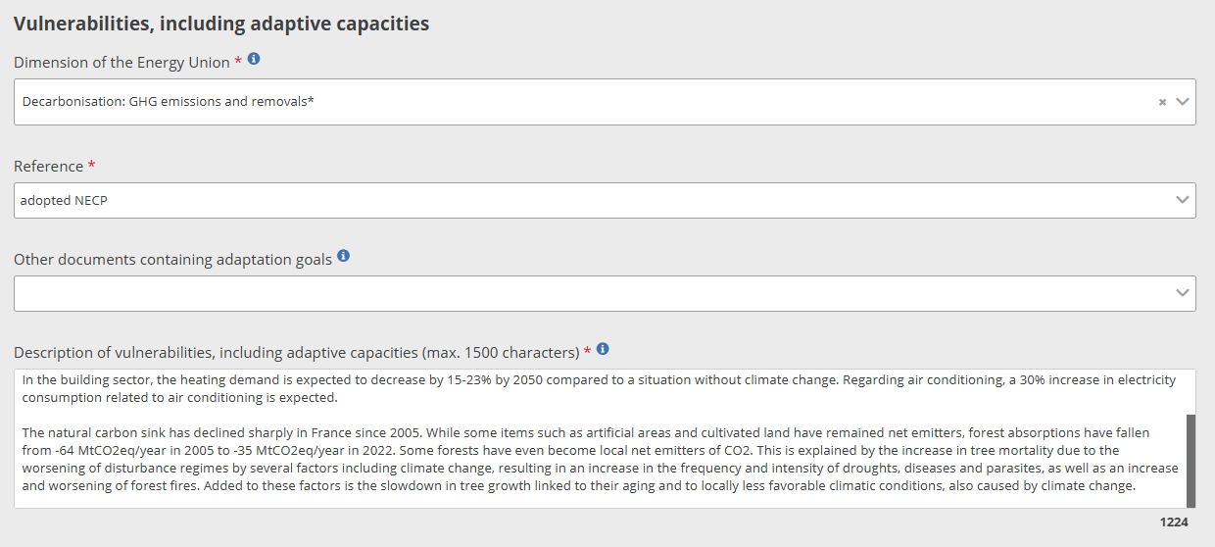
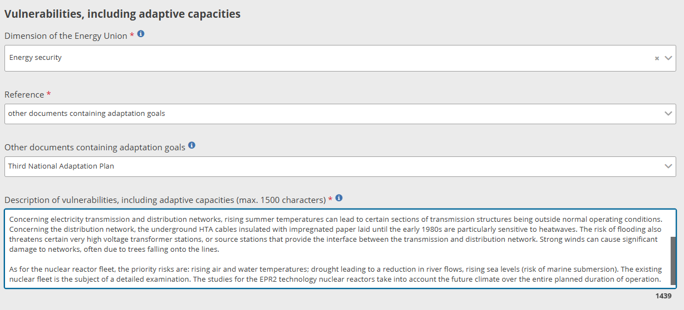
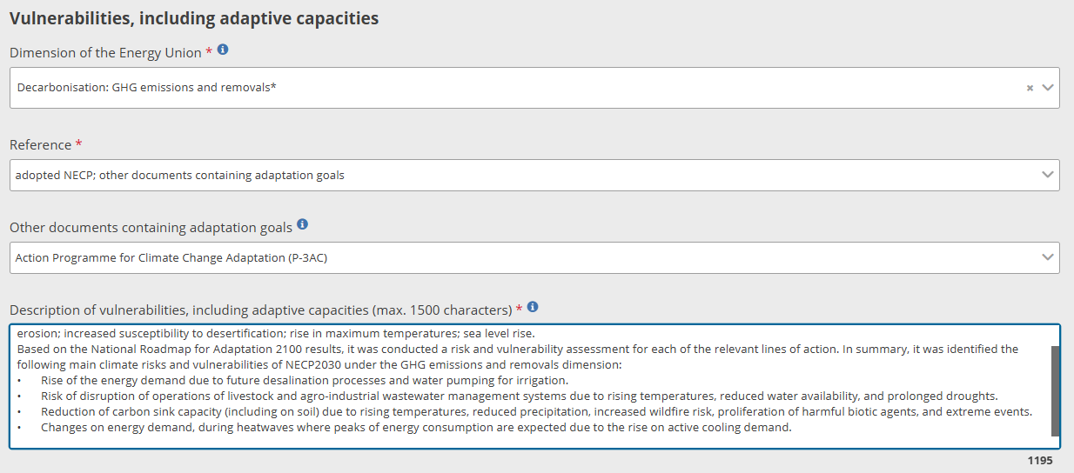
Good practices I
© Source
Notes:
France, Portugal

Slide 22
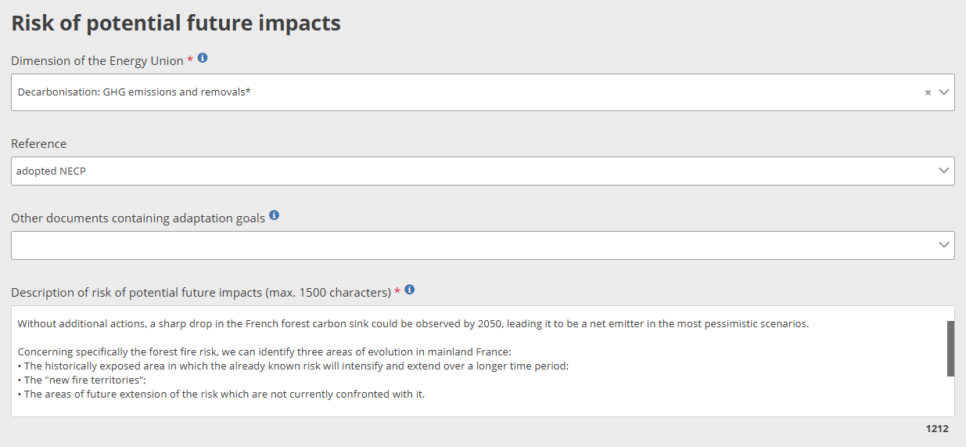
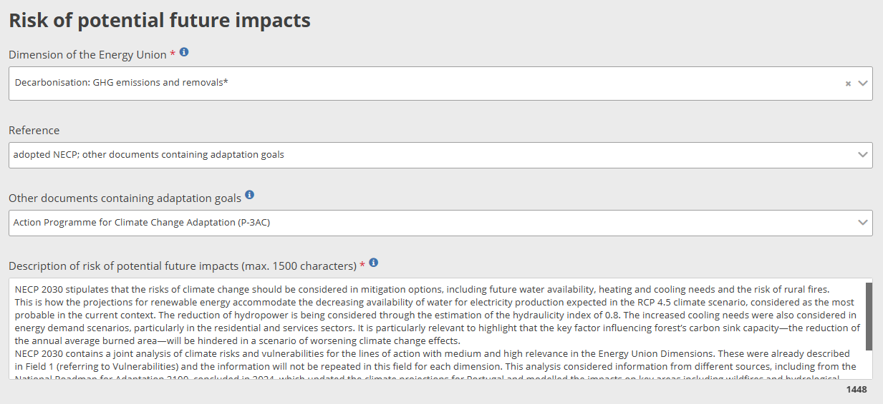
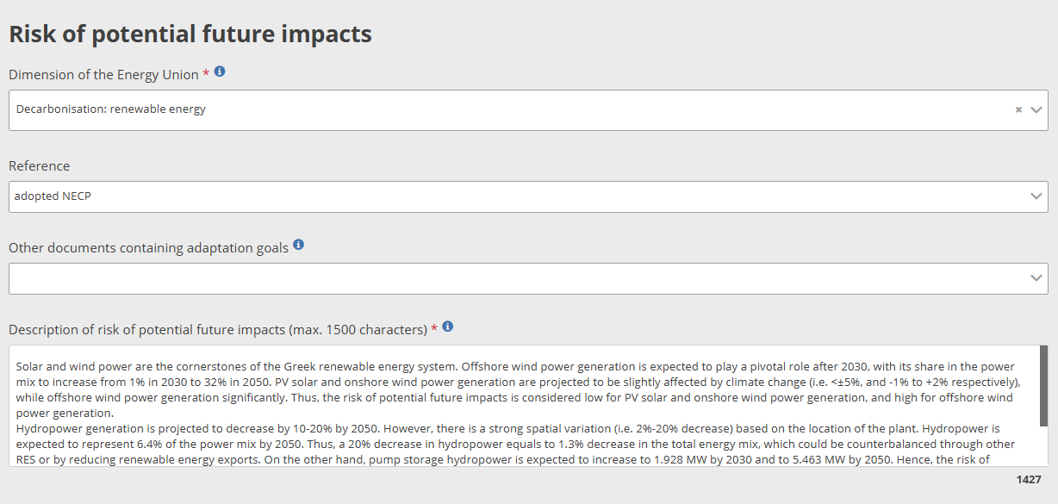
Good practices I
© Source
Notes:
France, Greece, Portugal

Slide 23
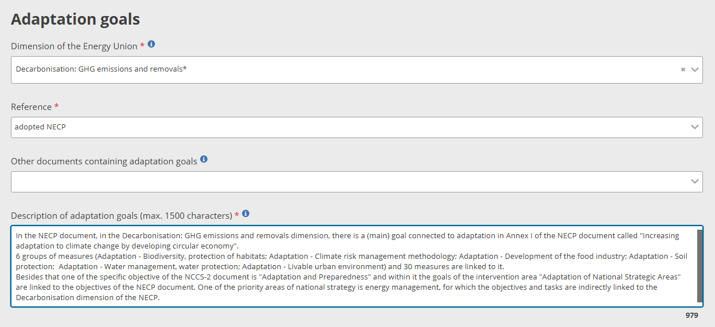
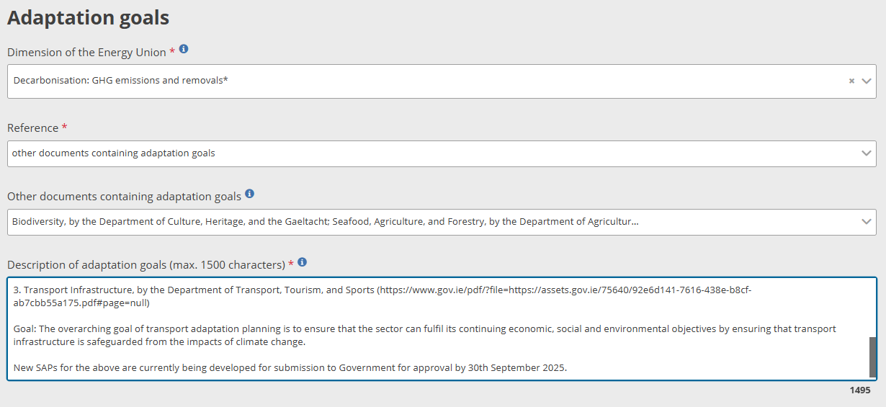
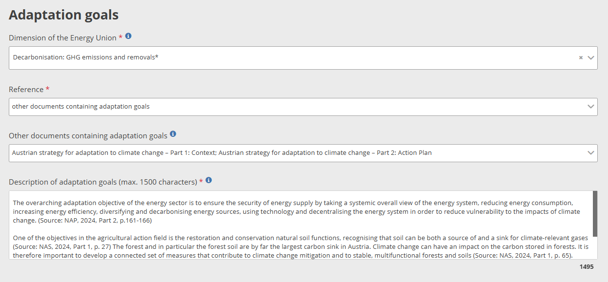
Good practices III
© Source
Notes:
Hungary, Austria, Ireland

Slide 24
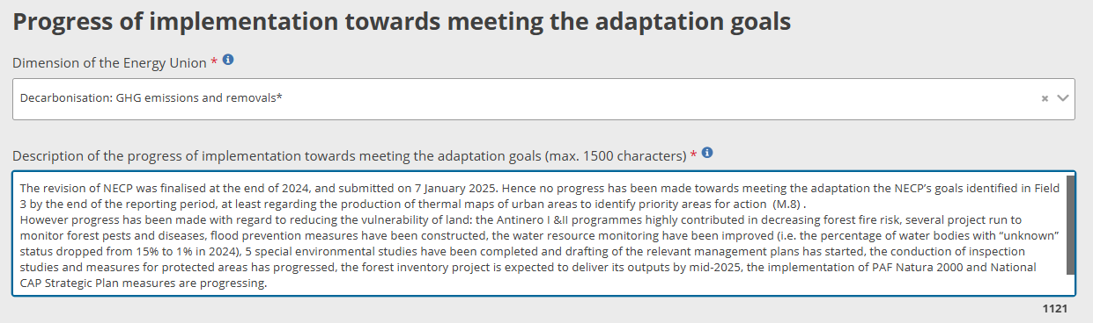
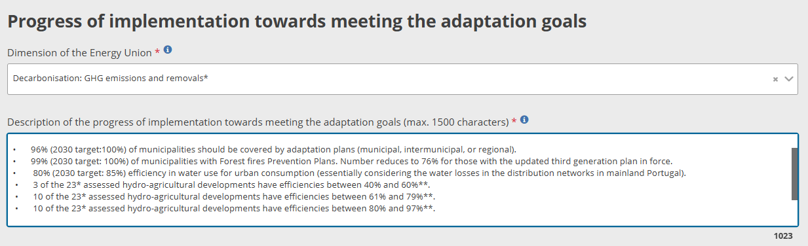
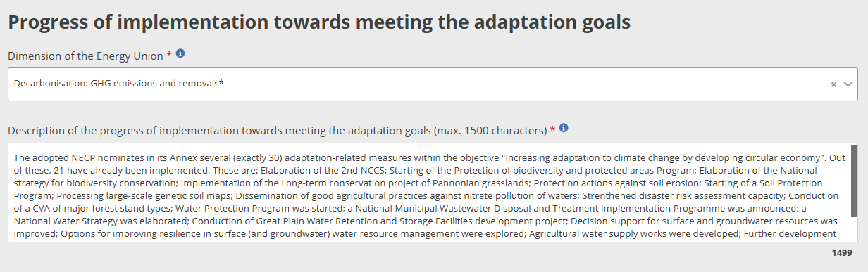
Good practices IV
© Source
Notes:
Greece, Portugal, Hungary

Slide 25
Voluntary elements
Challenges, gaps and barriers
Foreseen actions, budget and timeline related to the adaptation goals
Overview of the content of sub-national strategies, policies, plans and efforts related to the adaptation goals
Progress towards reducing climate impacts, vulnerabilities and risks
Progress towards increasing adaptive capacity
Progress towards addressing barriers
Information on vulnerabilities, including adaptive capacities, disaggregated by vulnerable group
Information on progress towards reducing climate impacts, vulnerabilities and risks, disaggregated by vulnerable group
© Source

Slide 26
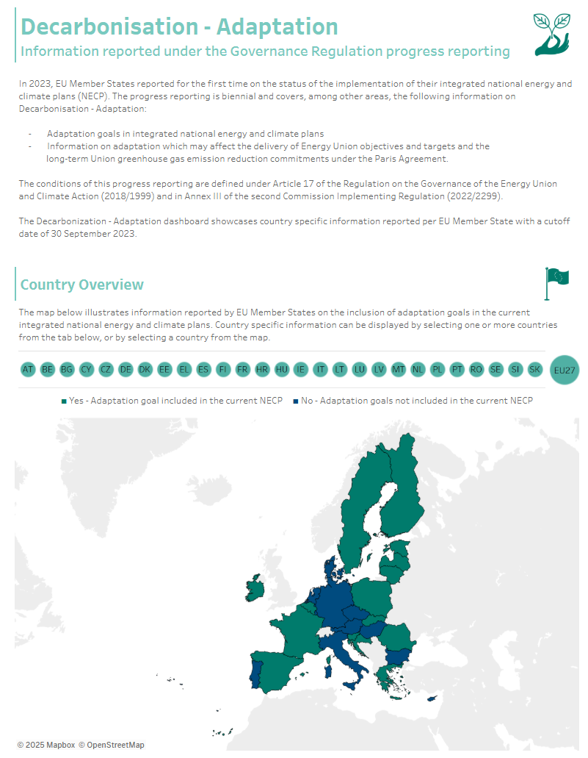
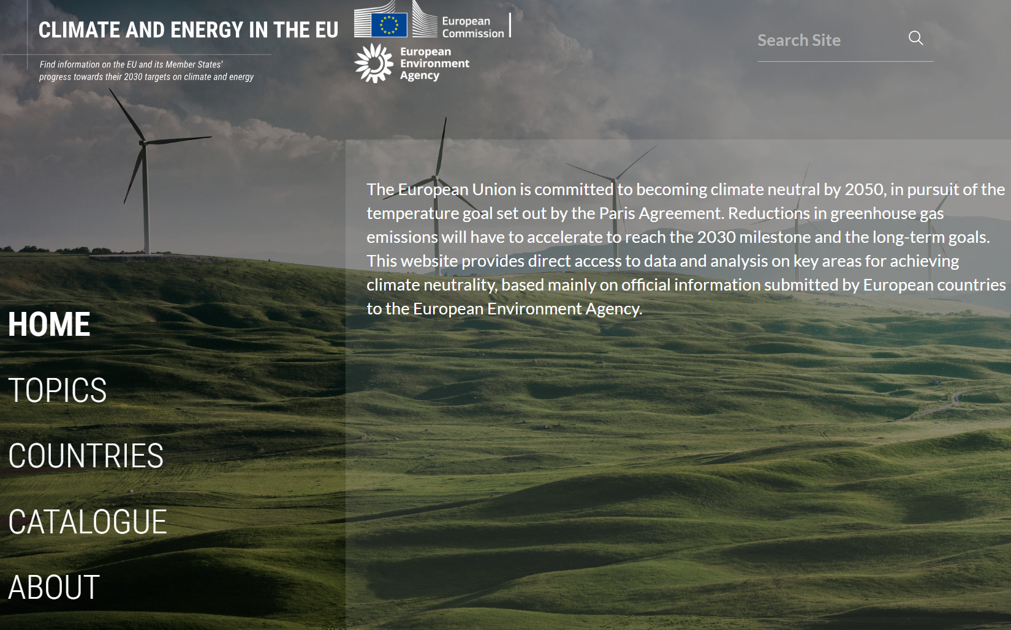
Where to find inspiration?
Climate and Energy in the EU
to be updated with 2025 data by December 2025
Article 17 Annex III Dashboard

Slide 27
?
© Hanifi Koç, Environment&Me 2025 / EEA
© Source

